Slide 1

Assignment 03 EPPS 6354
Prattasha Nawar Islam

Slide 2
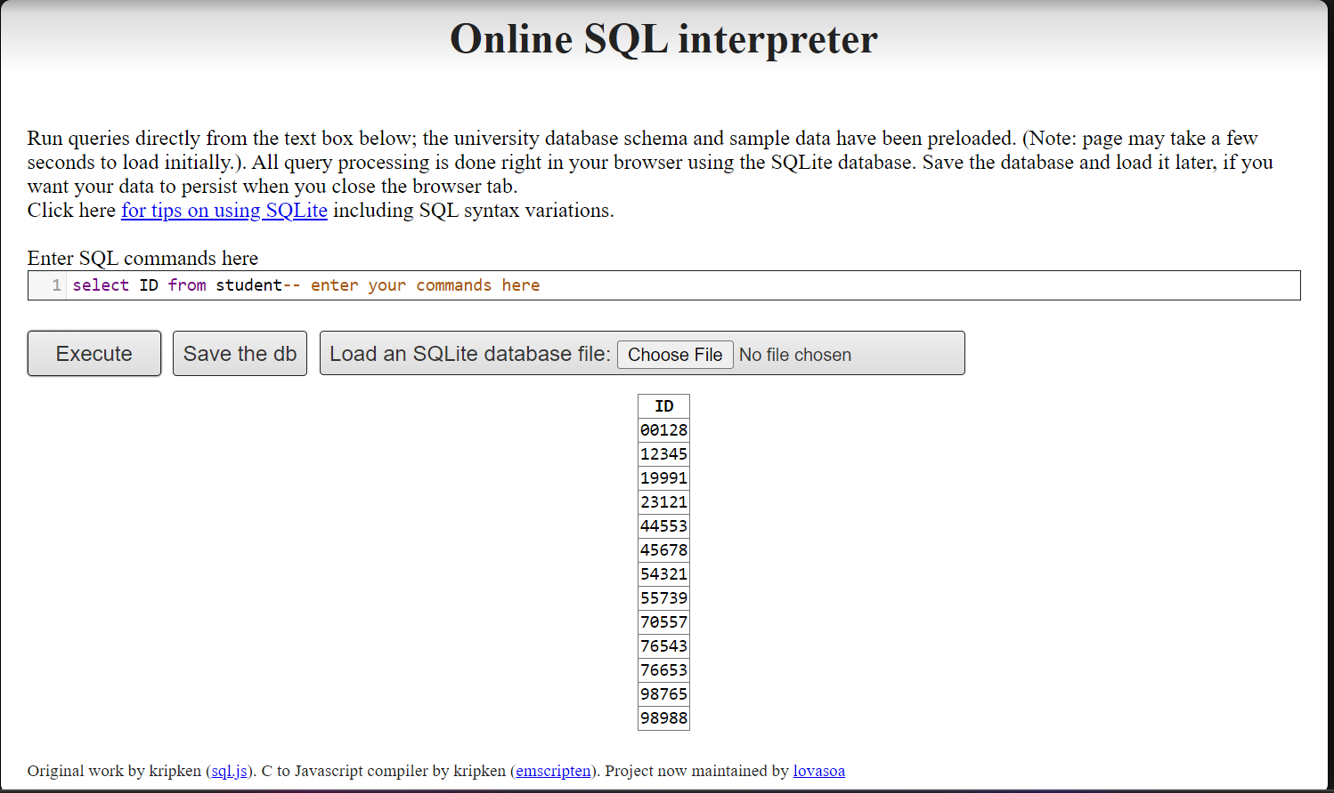
Q2.i. Student id list

Slide 3
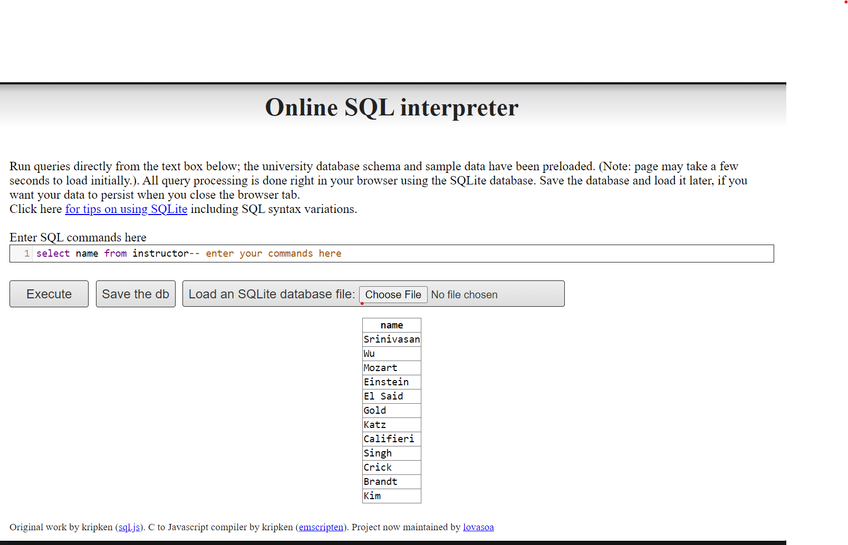
Q2.ii. Instructor name list

Slide 4
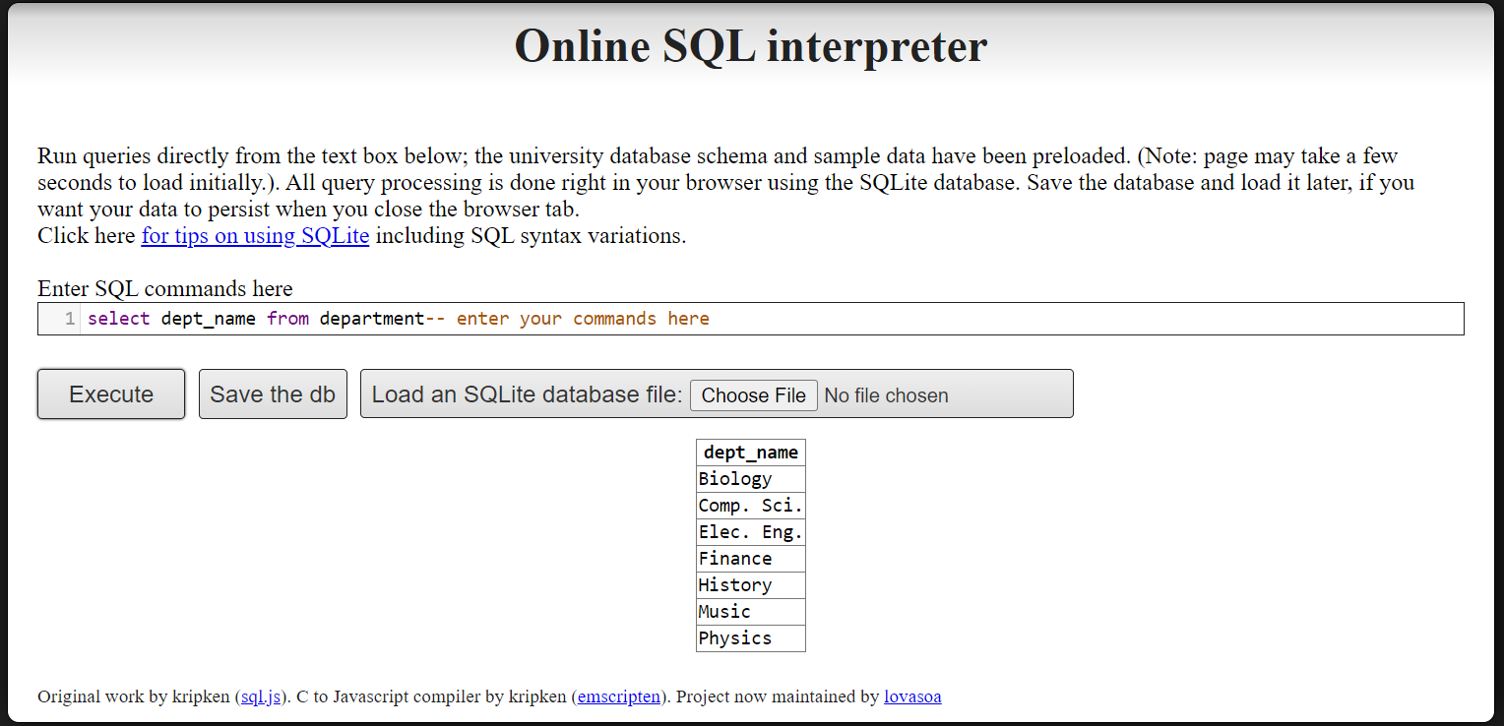
Q2.iii. DEPARTMENT name LIST

Slide 5
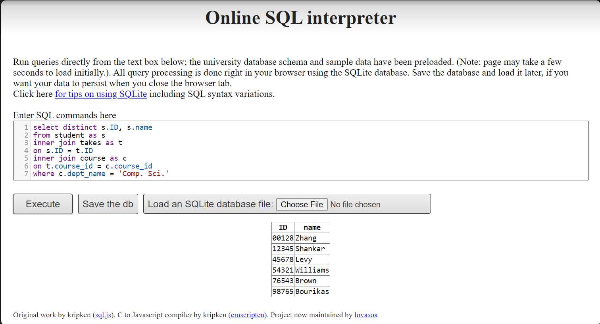
Q3.i.

Slide 6
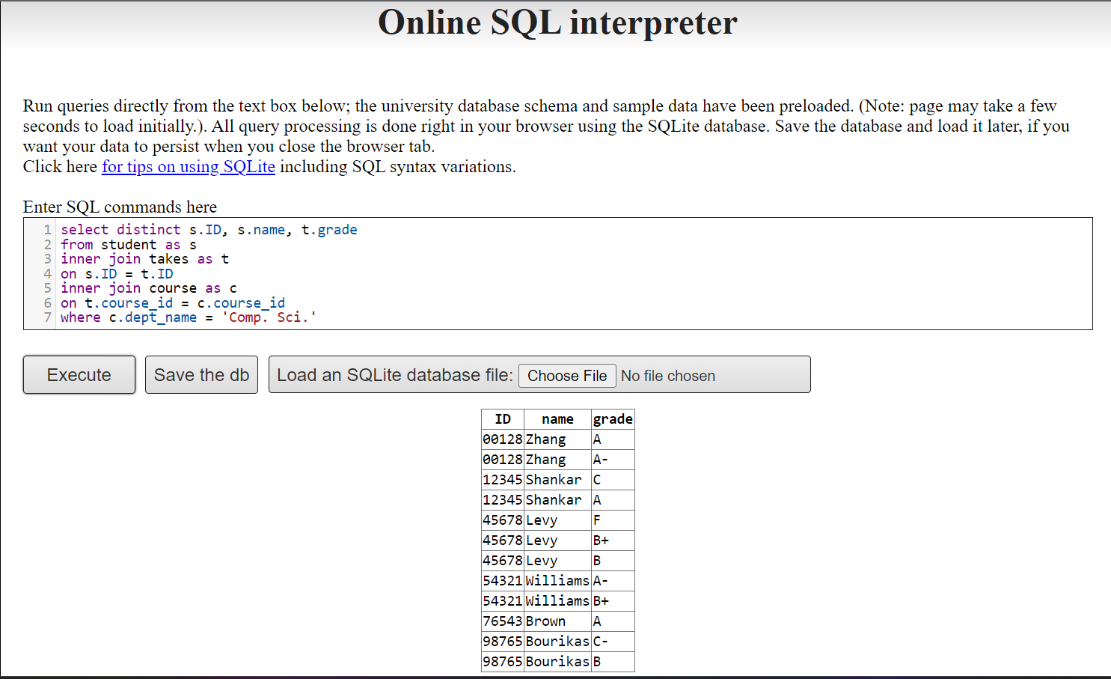
Q3.ii.

Slide 7
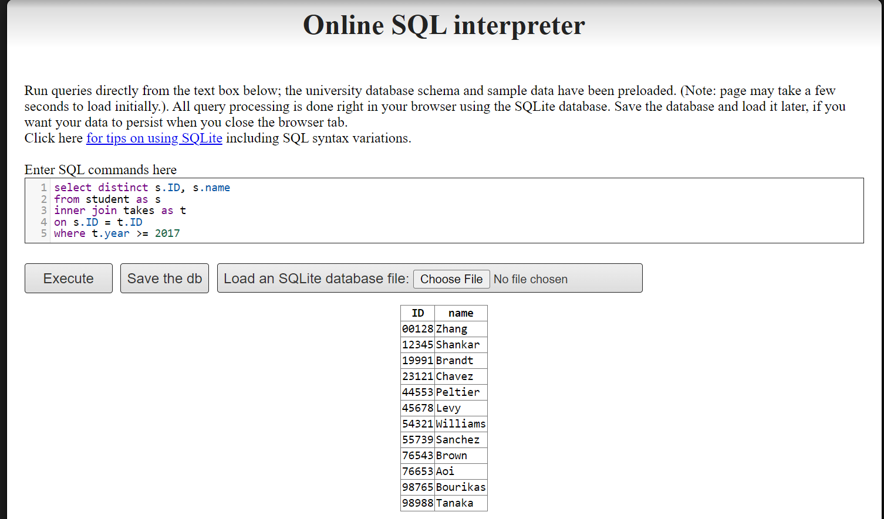
Q3.iii.

Slide 8
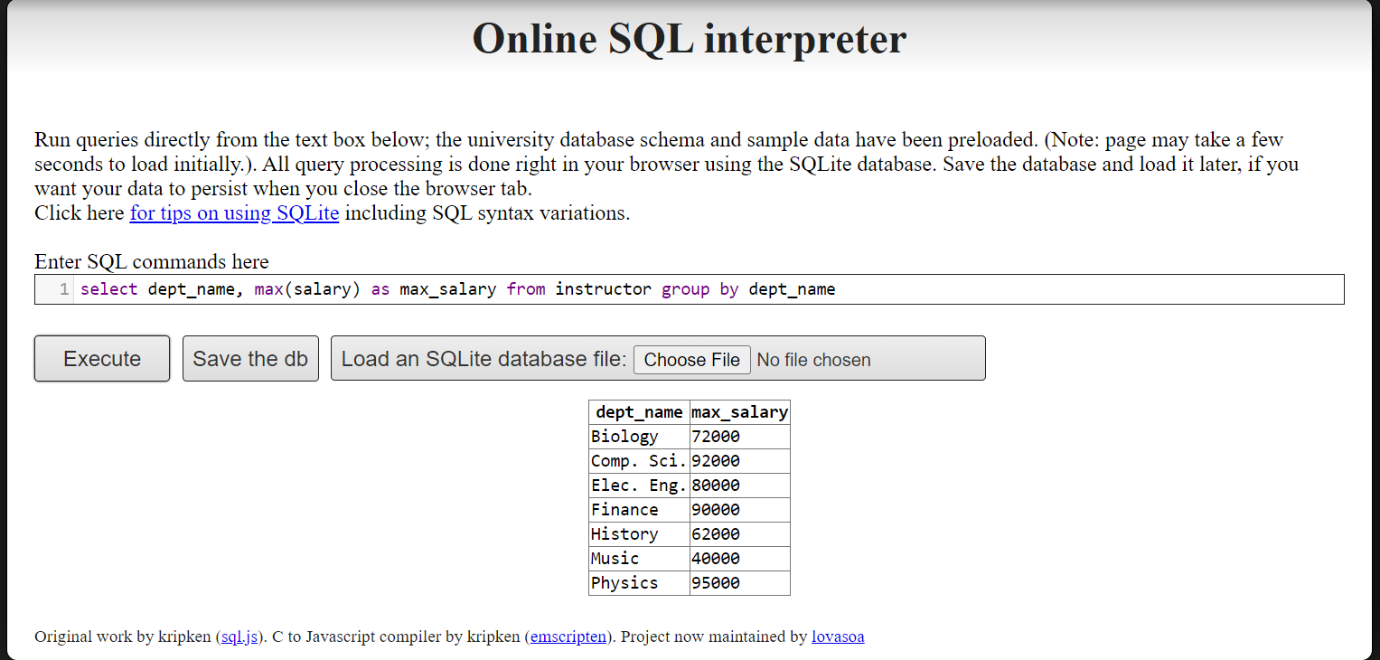
Q3.iv.

Slide 9
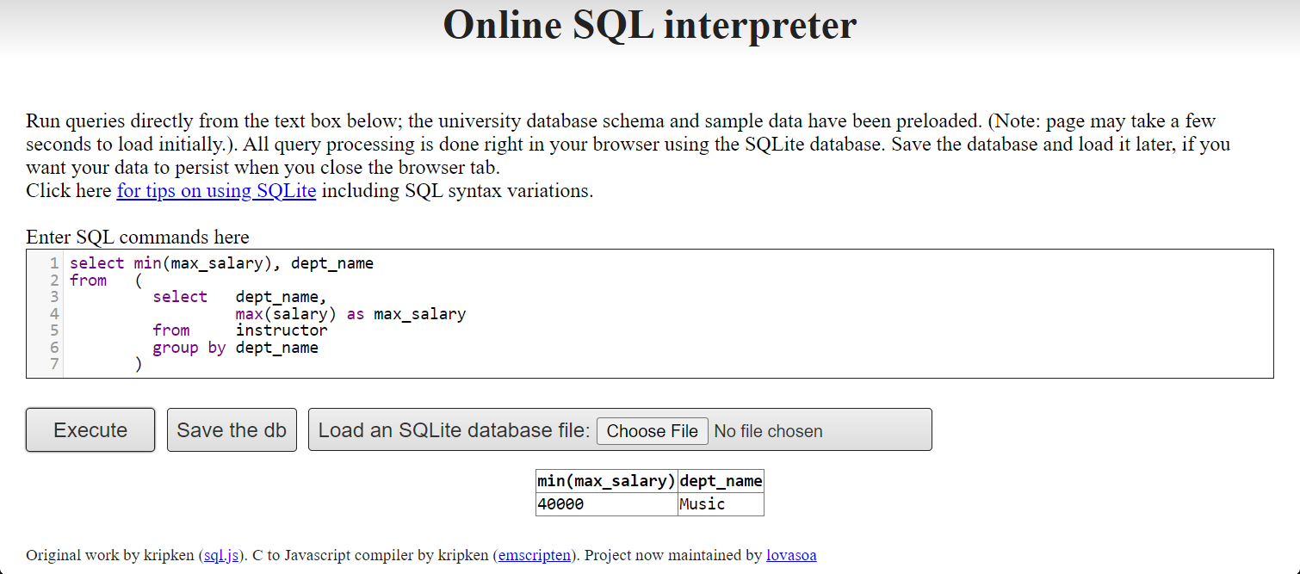
Q3.v.

Slide 10
Not in (subquery of who has given As) – Q4

